Slide 1

Trends in Technology Usage and Future Projections
Name: Sudeshna Mondal
Date: 08.04.2025

Slide 2

OUTLINE
Executive Summary
Introduction
Methodology
Results
Visualization – Charts
Dashboard
Discussion
Findings & Implications
Conclusion
Appendix

Slide 3

EXECUTIVE SUMMARY
Title Slide
Outline
Executive Summary
Introduction
Methodology
6–7. Programming Languages Trends
8–9. Database Trends
10–13. Dashboards
Insights from Dashboards
Overall Findings and Implications
Conclusion
Appendix

Slide 4

INTRODUCTION
Purpose: To analyze current and future technology trends in programming languages and databases, providing insights into industry shifts and emerging technologies.
Target Audience: Technology professionals, educators, and industry stakeholders interested in understanding future tech trends.
Value: The report provides data-driven insights that can guide decision-making for educational institutions, businesses, and tech professionals to align with industry demands.

Slide 5

METHODOLOGY
Data Sources:
Data was sourced from surveys on technology usage, including platforms like Stack Overflow and GitHub.
Industry reports and public datasets on programming languages and databases.
Collection Methods:
Data was collected through user responses in surveys, historical usage data, and future projections based on market analysis.
Key Wrangling Steps:
Cleaning and preprocessing: Removed duplicates, handled missing values, and unpivoted data for analysis.

Slide 6
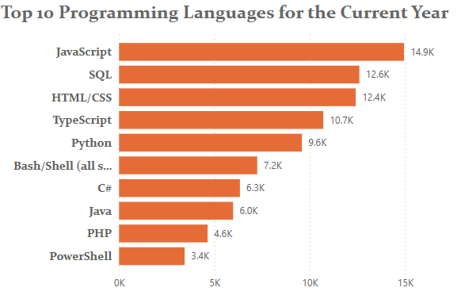
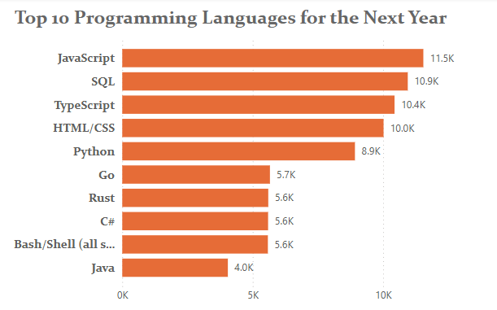
PROGRAMMING LANGUAGE TRENDS
Current Year
Next Year

Slide 7
PROGRAMMING LANGUAGE TRENDS - FINDINGS & IMPLICATIONS
Implications
The user’s skills match top industry trends in web and data technologies.
Knowledge of Go and Rust gives a future-ready advantage.
A broad tech stack boosts adaptability and job prospects across domains.
Findings
JavaScript tops the list with 11,541 users wanting to work with it.
SQL and Python are highly desired, reflecting demand in data roles.
Go and Rust are rising, showing interest in modern, efficient back-end development.

Slide 8
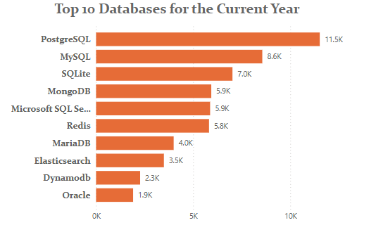
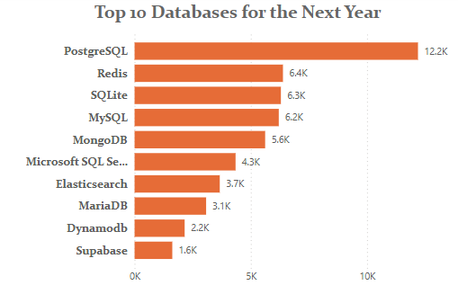
DATABASE TRENDS
Current Year
Next Year

Slide 9
DATABASE TRENDS - FINDINGS & IMPLICATIONS
Findings
PostgreSQL is the most preferred, with 12,193 responses.
There’s strong interest in both relational (MySQL, SQL Server) and NoSQL (MongoDB, Redis) databases.
Modern platforms like Supabase and Elasticsearch are gaining traction.
Implications
The user is aligned with industry trends in versatile, modern data storage.
Skills in both traditional and cloud-native databases improve adaptability.
Interest in real-time and search-optimized tools expands project scope and opportunities.

Slide 10

DASHBOARD

Slide 11
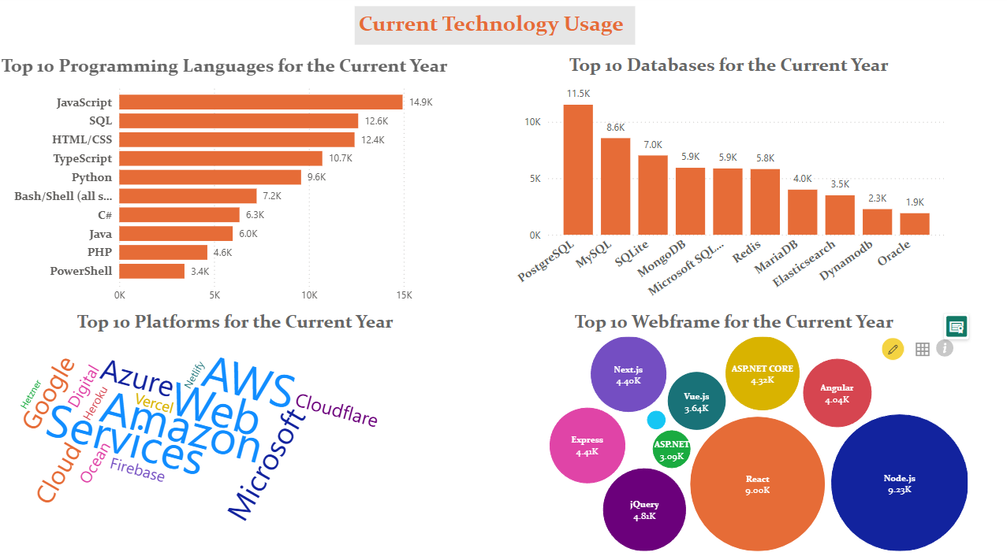
DASHBOARD TAB 1

Slide 12
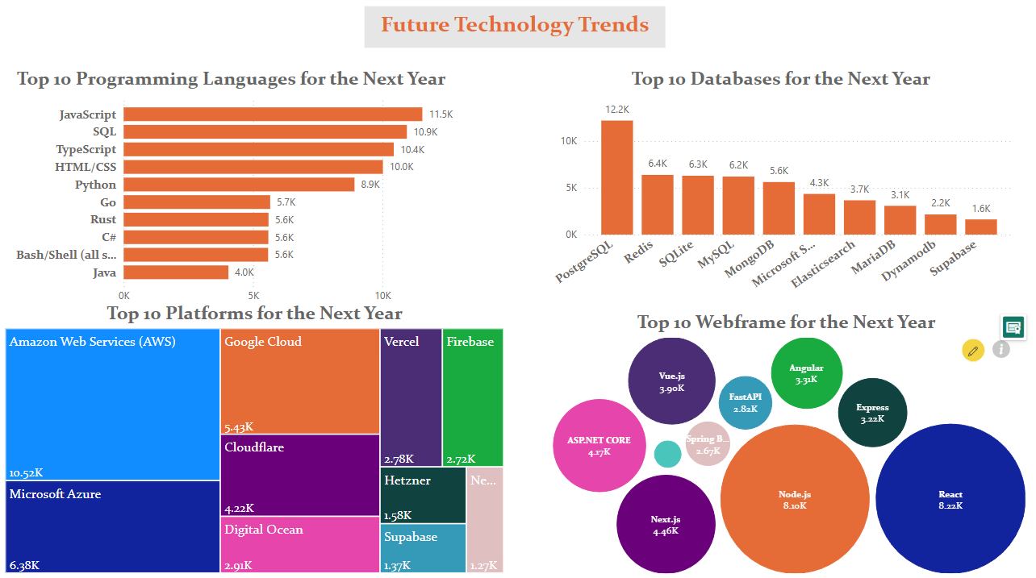
DASHBOARD TAB 2

Slide 13
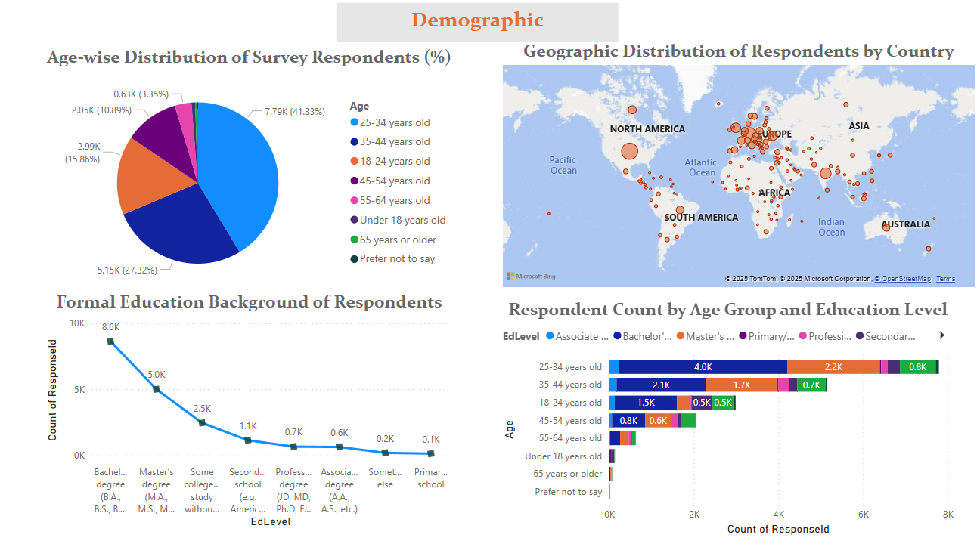
DASHBOARD TAB 3

Slide 14
DISCUSSION

Slide 15
OVERALL FINDINGS & IMPLICATIONS
Findings
Web-centric focus: Dominant web technologies (JavaScript, SQL, AWS).
Modern tech adoption: Shift towards TypeScript, Next.js, PostgreSQL.
Young, educated demographic: Survey skewed towards 25-34 year olds, with high education, in North America/Europe.
Implications
Prioritize web skills: Demand for web developers is high.
Adapt to change: Continuous learning is crucial.
Seek diverse data: Need for broader demographic representation.

Slide 16

CONCLUSION
The technology landscape is shifting towards more cloud-centric solutions and newer programming languages.
The demand for relational databases will continue, but NoSQL solutions are gaining ground in specific use cases.
Organizations and educational institutions should align their strategies to incorporate these emerging technologies.
Industry-academia collaboration can accelerate innovation.

Slide 17

APPENDIX
Include any relevant additional charts, or tables that you may have created during the analysis phase.

Slide 18
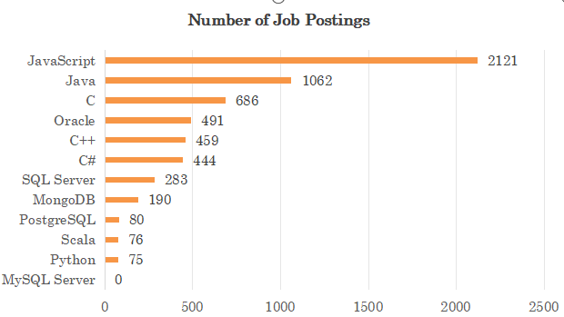
JOB POSTINGS
In Module 1 you have collected the job posting data using Job API in a file named “job-postings.xlsx”. Present that data using a bar chart here. Order the bar chart in the descending order of the number of job postings.

Slide 19
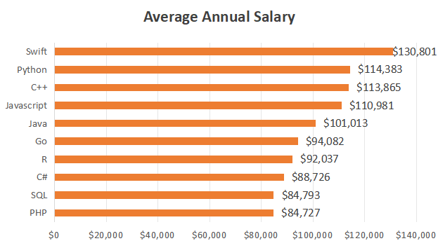
POPULAR LANGUAGES
In Module 1 you have collected the job postings data using web scraping in a file named “popular-languages.csv”. Present that data using a bar chart here. Order the bar chart in the descending order of salary.

